Slide 1
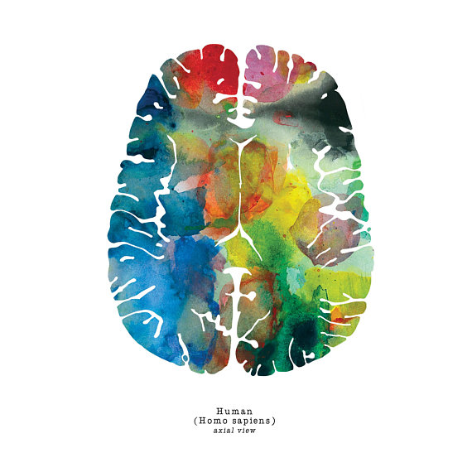
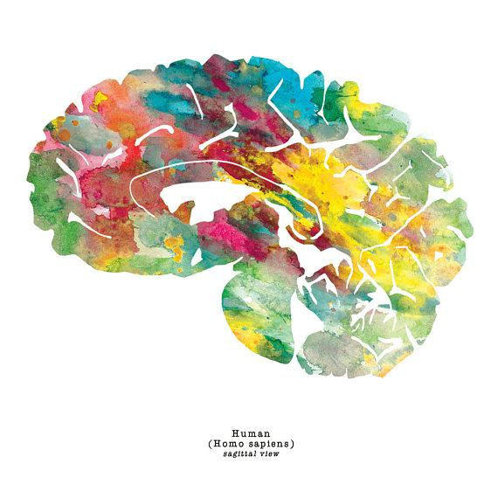
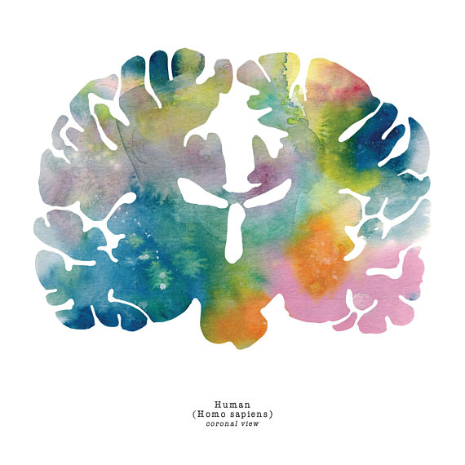
J. Sayuri.
The Reimagined
Brain

Slide 2
INTRODUCTION TO MRI
Lynne J. Williams, Ph.D.
BCCH MRI Research Facility
May 22, 2018
Functional MRI II

Slide 3
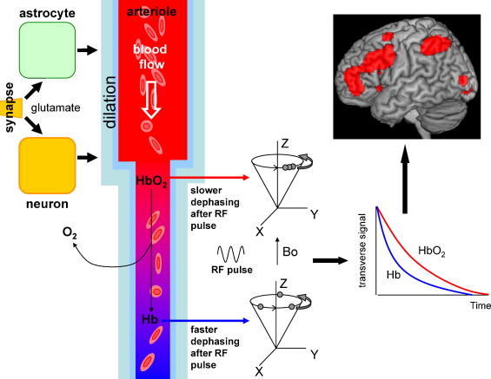
REVIEW
Harris et al. (2011). Developmental Cognitive Neuroscience, 1, 3

Slide 4
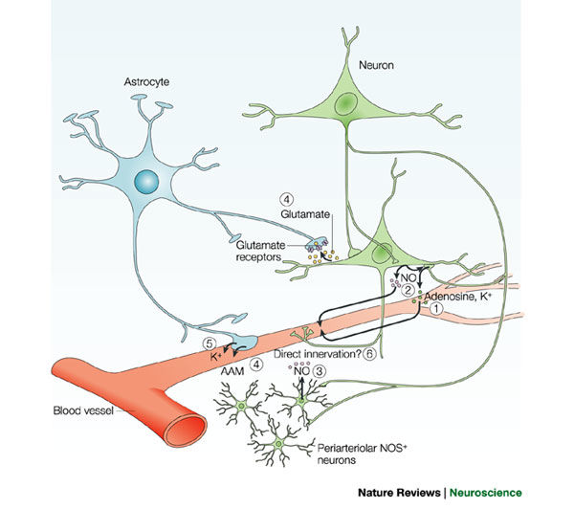
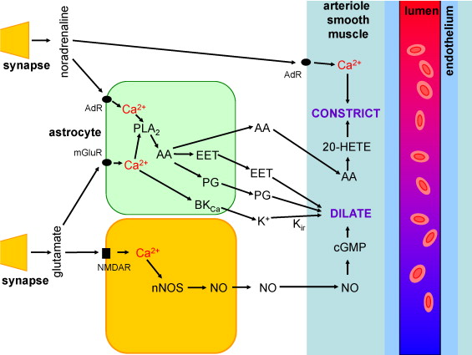
REVIEW
D’Esposito et al. (2003). Nature Reviews Neuroscience, 4
Harris et al. (2011). Developmental Cognitive Neuroscience, 1, 3

Slide 5

cerebrovascular disease
structural lesions (compression)
blood
flow
blood
volume
medications
autoregulation (vasodilation)
hypoxia
BOLD
contrast
hypercapnia
volume status
anesthesia/sleep
anemia
BOLD IS BASED IN PHYSIOLOGY
smoking
oxygen
utilization
degenerative disease

Slide 6
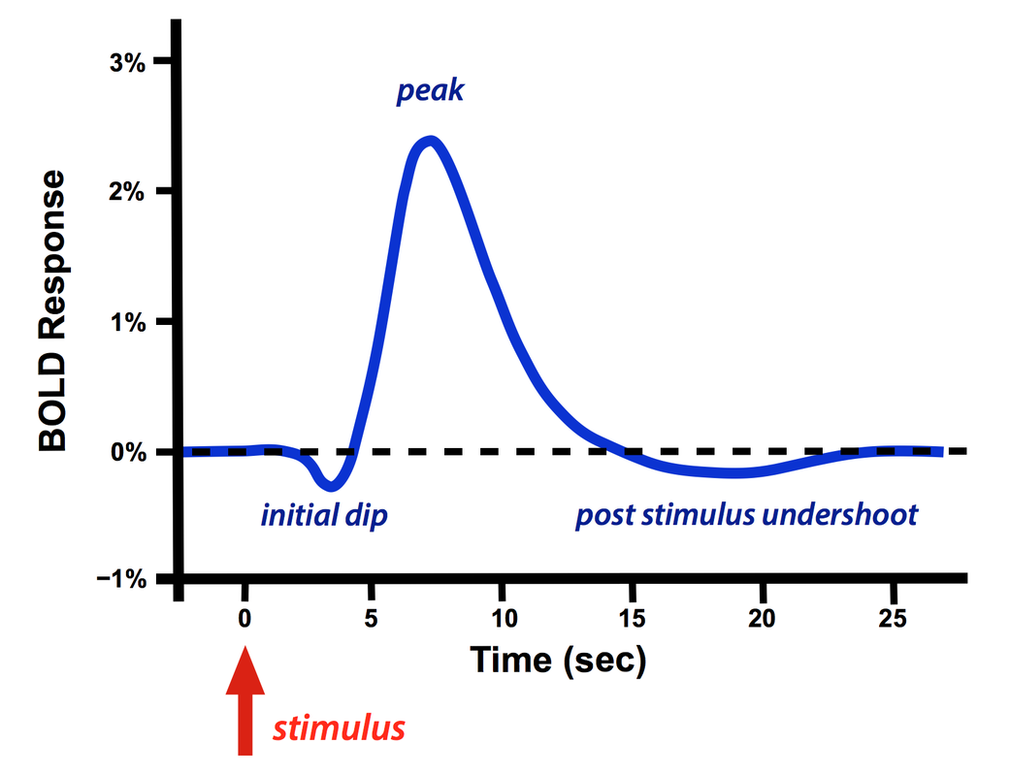
BOLD
RESPONSE

Slide 7
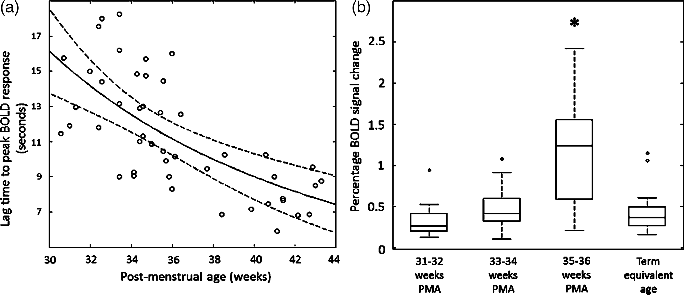
CHANGES IN BOLD
WITH DEVELOPMENT
From: Maturation of Sensori-Motor Functional Responses in the Preterm Brain
Cereb Cortex. 2015;26(1):402-413. doi:10.1093/cercor/bhv203
Cereb Cortex | © The Author 2015. Published by Oxford University PressThis is an Open Access article distributed under the terms of the Creative Commons Attribution License (http://creativecommons.org/licenses/by/4.0/), which permits unrestricted reuse, distribution, and reproduction in any medium, provided the original work is properly cited.
Notes:
Figure 2. Maturational changes in the temporal characteristics and amplitude of the identified functional brain activity (a). The lag time to the positive peak of the identified response decreases systematically with increasing PMA (data shown with robust regression line with prediction error bands). (b) The amplitude of BOLD signal change within the identified clusters of activity are significantly higher at the conclusion of the third trimester (35–36 weeks PMA) in comparison to younger infants and those at term equivalent age (line represents data median; box represents data lower and upper quartile; *P < 0.05 Mann–Whitney U-test with Holm–Bonferroni correction).
7

Slide 8
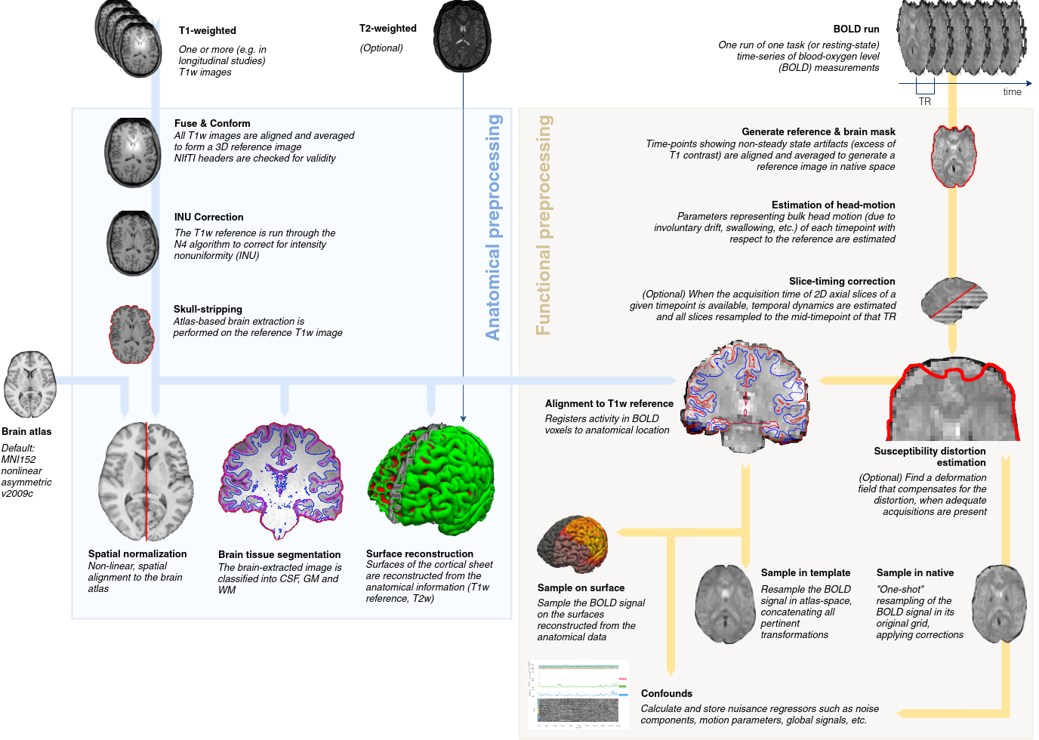
LAB REVIEW
BOLD reference image estimation
Susceptibility distortion correction
Slice time correction
EPI to T1w registration
Confounds estimation
Head motion estimation
T2* coregistration
Preprocessed BOLD in native space
EPI to MNI transformation
Esteban et al. (2018). FMRIPrep: a robust preprocessing pipeline for functional MRI. bioRxiv. 2018. 306951; doi:10.1101/306951

Slide 9
WEEK 4
FUNCTIONAL MRI I
TODAY’S CLASS
Experimental Design
Modeling the BOLD response
Stimulus Based designs
Freerunning designs

Slide 10
EXPERIMENAL
DESIGN
Because fMRI BOLD data is not an absolute measure of neuronal activity, all study designs must provide the opportunity to statistically contrast the neuronal activity of interest with a suitable rest or background condition
STUDY DESIGN IS OF PARAMOUNT IMPORTANCE
www.yourwebsite.com

Slide 11
WHAT DOES
fMRI TELL YOU?
fMRI CAN TELL YOU:
Relative local activity
fMRI CANNOT TELL YOU:
Absolute neural activity
Excitation/Inhibition
Necessity of region for task
Rapid temporal information
www.yourwebsite.com

Slide 12
WHY?
(Hypothesis)
WHERE? (Neuroanatomy)
WHAT?
(Behaviour)
HOW?
(fMRI Study Design)
STUDY
DESIGN

Slide 13
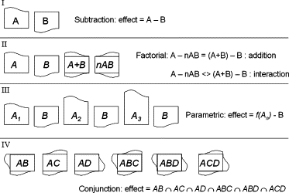
SUBTRACTION
CHOICES
FOR
EXPERIMENTAL
PARADIGM
FACTORIAL
PARAMETRIC
CONJUNCTION
Amaro, Jr. & Barker (2006). Study Design in fMRI: Basic Principles. Brain & Cognition, 60, 220-232.

Slide 14
SUBTRACTION

Slide 15
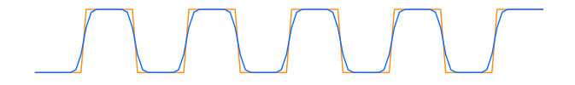
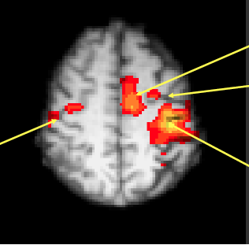
fMRI signal
Task paradigm
rest
move
rest
move
rest
move
rest
move
rest
move
Time
ACTIVATION
FOR MOVEMENT
VS REST
SMA
PMCc
M1i
M1c

Slide 16
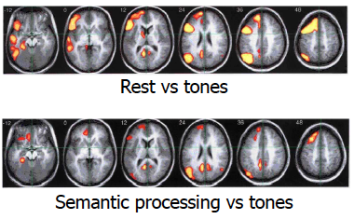
WATCH
YOUR BASELINE
Rest may not be truly rest
Need to control as much as possible to isolate component of interest
Even if a task does not explicitly involve a particular component, subjects may engage in it anyways
Rest − Tones
Semantic − Tones
Binder et al. (1999). Conceptual processing during the conscious resting state. Journal of Cognitive Neuroscience, 11

Slide 17
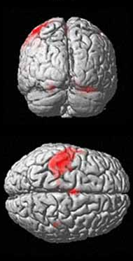
fMRI signal
Task paradigm
rest
move
rest
move
rest
move
rest
move
rest
move
Time
SUBTRACTION
Used a lot in brain mapping/localizing functions
Finds unique activations relative to baseline condition
Bonzano et al. (2015). An engineered glove for investigating the neural correlates of finger movements using functional magnetic resonance imaging. Front. Hum. Neurosci., 14 September, https://doi.org/10.3389/fnhum.2015.00503

Slide 18
SINGLE WORD READING
Subtraction | Control | Task | Hypothetical Cognitive Operations
Sensory | Fixation | Passive words | Passive sensory processing
Production | Passive words | Repeat words | Motor programming and output
Association | Repeat words | Generate words | Semantic association, selection
Sonia Bishop after
Petersen et al (1988). Nature

Slide 19
PROBLEMS WITH SUBTRACTION DESIGNS
Depends upon assumption of pure insertion
Idea that you can insert a single component process into a task without affecting other processes
A
B
A + B
A × B
A × B
Sonia Bishop after
Friston et al. 1996, Neuroimage

Slide 20
FACTORIAL

Slide 21
FACTORIAL DESIGNS
 | No vision | Vision
No touch |  | 
Touch |  | 
}
MAIN EFFECT
OF TOUCH
}
MAIN EFFECT OF VISION
Allow you to examine interactions between component processes without assuming pure insertion

Slide 22
PARAMETRIC

Slide 23
CONJUNCTION

Slide 24
CONJUNCTION DESIGNS
Cognitive subtraction
 | Task
 | A | B
Process 1
2
3
4
5
Cognitive Conjunction
 | Task Pair 1 |  | Task Pair 2
 | A | B | A | B
Process 1
2
3
4
5
Activation vs. baseline
Commonalities in activation vs. baseline across task pairs
Price & Friston (1997). Neuroimage 5, 261-170

Slide 25
AN EXAMPLE
Sometimes we want to use an experiment from the psychology or EEG literature in our fMRI studies
This requires some changes to be made …
Example: the anti-saccade task
Example courtesy of Sonia Bishop

Slide 26

Notes:
LiveSlide Site
[https://www.youtube.com/watch?v=1NQ0hTBkRS8]

Slide 27
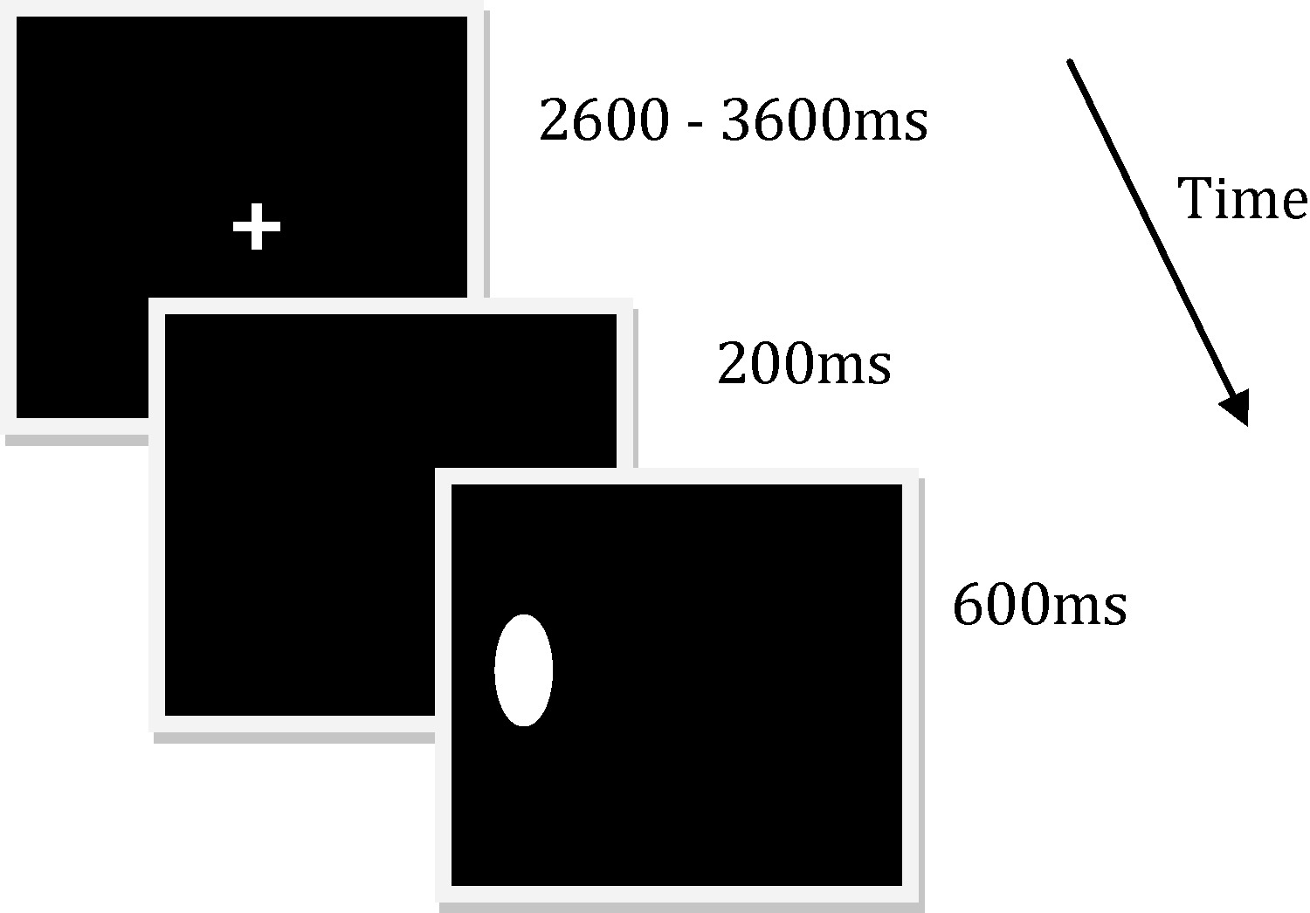
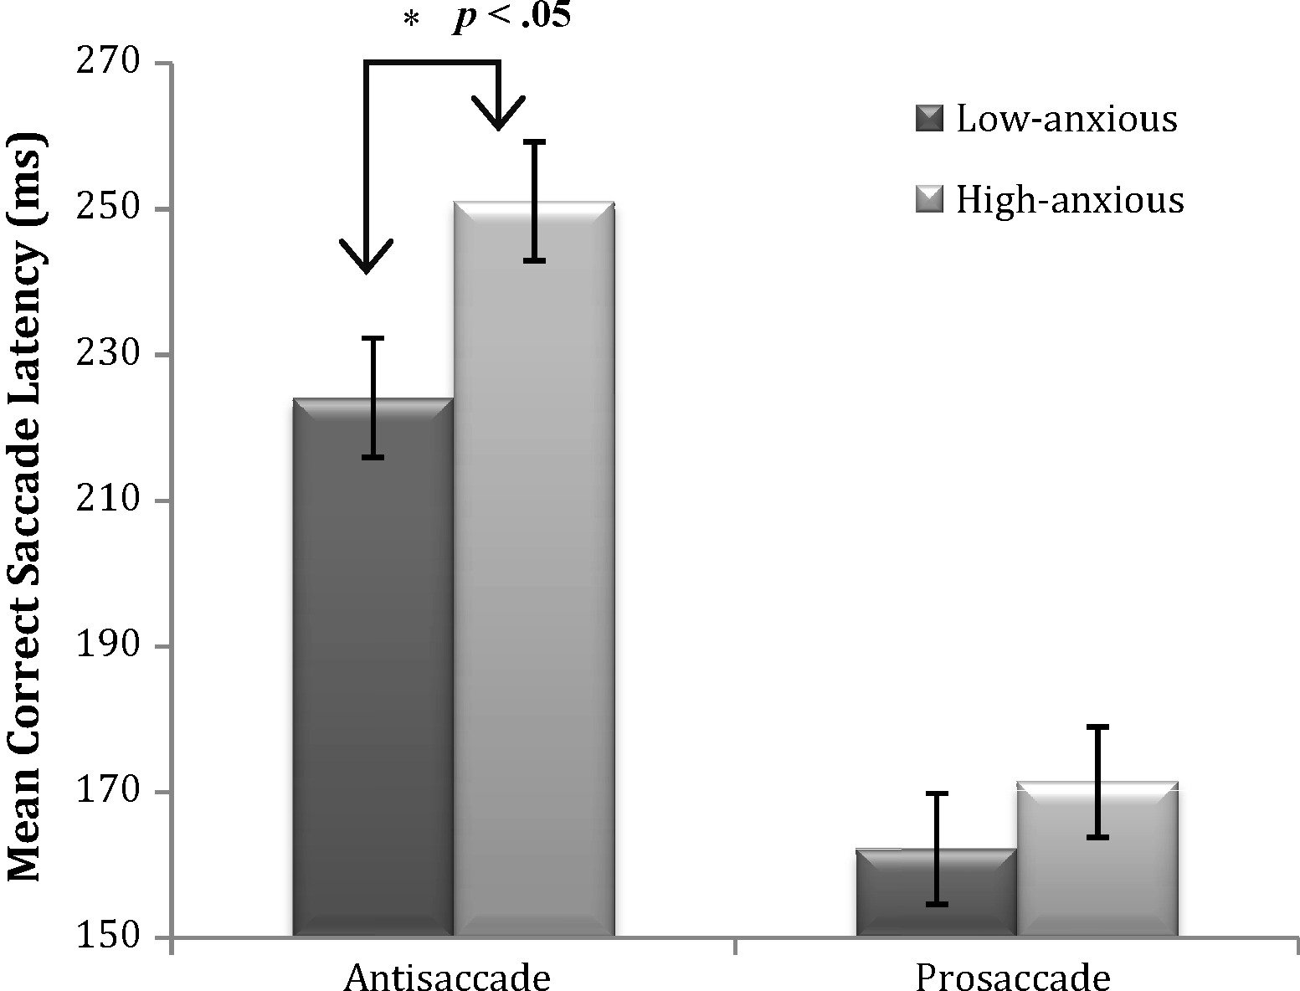
AN EXAMPLE
Sometimes we want to use an experiment from the psychology or EEG literature in our fMRI studies
This requires some changes to be made …
Example: the anti-saccade task
Ansari & Derakshan (2011). Neuropsychologia 49

Slide 28
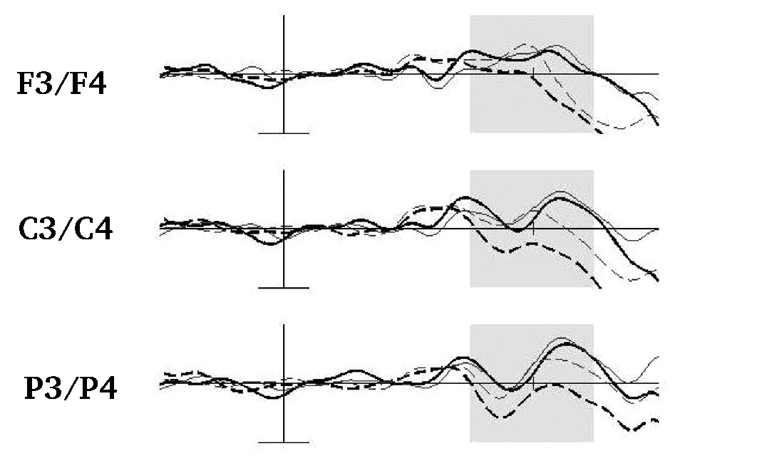
AN EXAMPLE
Sometimes we want to use an experiment from the psychology or EEG literature in our fMRI studies
This requires some changes to be made …
Example: the anti-saccade task
Antisaccade (black)
Prosaccade (grey)
Low anxious (dotted line)
High anxious (solid line)
50ms pretarget to 50 ms post-target
Ansari & Derakshan (2011). Neuropsychologia 49

Slide 29
AN EXAMPLE
Example: the anti-saccade task
Issues converting to fMRI
It will be hard to separate BOLD response to preparatory activity just before target from BOLD response to seeing the oval or making the saccade

Slide 30
AN EXAMPLE
Example: the anti-saccade task
Solution??
‘Half’ trials (i.e. only preparation, no saccade)
¹/₃ of trials subjects prepare but instead of the oval the screen remains blank until fixation returns signalling next trial
SUBTRACTION
half antisaccade trial vs half prosaccade trial should reflect preparation for antisaccade
examine anti-saccade activity linked to the making of the saccade by subtracting half antisacade trial activity from full antisacade trial activity

Slide 31
AN EXAMPLE
Example: the anti-saccade task
Solution??
‘Half’ trials (i.e. only preparation, no saccade)
¹/₃ of trials subjects prepare but instead of the oval the screen remains blank until fixation returns signalling next trial
CONJUNCTION
examine common preparatory response to half antisaccade and prosaccade trials

Slide 32
WEEK 4
FUNCTIONAL MRI I
CHOICES FOR
fMRI PROTOCOL

Slide 33
BOLD
RESPONSE
HRF is slow to peak
4 to 6 seconds after stimulus onset
Time-to-peak varies across brain regions and subjects
Returns to baseline 21 to 30 seconds after stimulus onset

Slide 34
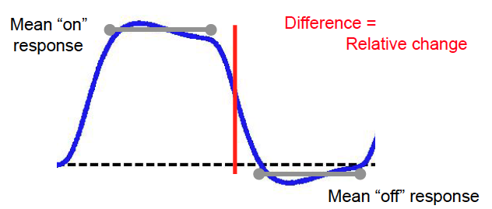
BOLD
IS A
RELATIVE
MEASURE
Sensitivity depends on maximizing relative change

Slide 35
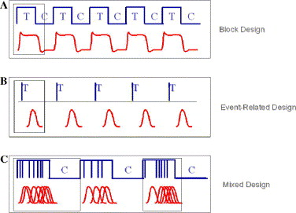
Block design
BASIC
DESIGNS
Event-related design
Mixed design
Amaro, Jr. & Barker (2006). Study Design in fMRI: Basic Principles. Brain & Cognition, 60, 220-232.

Slide 36
WEEK 4
FUNCTIONAL MRI I
BLOCK
DESIGNS

Slide 37
Block design
Event-related design
< 20% efficiency relative to block designs
EFFICIENCY
Mixed design
Block designs are more efficient than event-related or mixed designs
Higher efficiency means less time to have the same statistical power
Amaro, Jr. & Barker (2006). Study Design in fMRI: Basic Principles. Brain & Cognition, 60, 220-232.

Slide 38
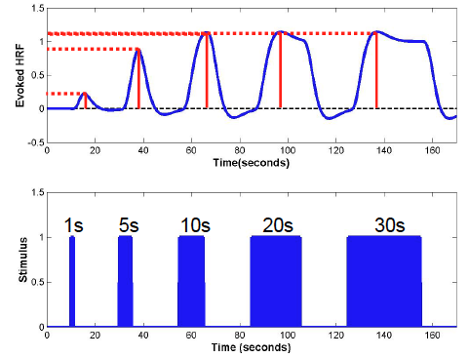
EFFICIENCY
No additional benefit to increasing block length past 10 to 20 seconds
NB: The shorter the block, the more attentional demands there are
Sonia Bishop (2015)

Slide 39
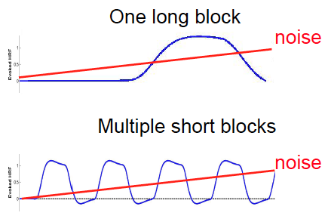
BLOCK
LENGTH
TEAM
NB: Longer blocks have more overlap between design frequency and noise frequency / impact of scanner drift
Sonia Bishop (2015)

Slide 40
BLOCK
LENGTH
TEAM
Block lengths ~20 seconds are most efficient and minimize set shifting
Sonia Bishop (2015)

Slide 41
DRAWBACKS
OF BLOCK
DESIGNS

Lose ability to distinguish individual responses
Confounds psychological and physiological effects
Habituation/Adaptation
Expectation
Set (Strategy)

Slide 42
WEEK 4
FUNCTIONAL MRI I
EVENT-RELATED
DESIGNS

Slide 43
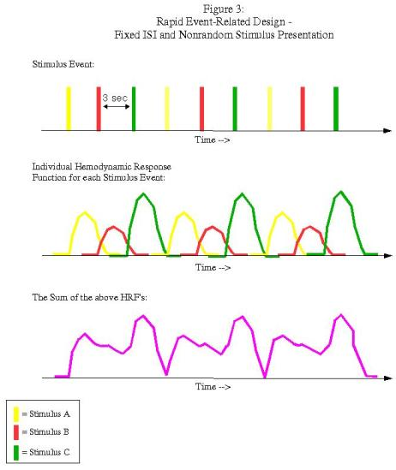
EVENT-RELATED
EFFICIENCY
FIXED INTER-STIMULUS
INTERVALS
YOUR
TITLE HERE
Andy’s Brain Blog

Slide 44
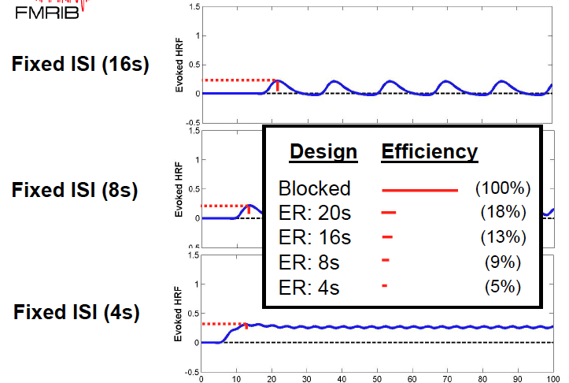
EVENT-RELATED
EFFICIENCY
FIXED INTER-STIMULUS
INTERVALS
Fixed ISI
(16 s)
YOUR
TITLE HERE
Fixed ISI
(8s)
Fixed ISI
(4s)

Slide 45
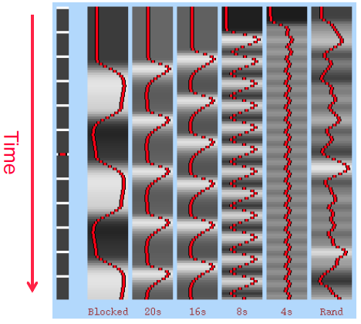
EVENT-RELATED
EFFICIENCY
RANDOM VS. FIXED ISI
YOUR
TITLE HERE
Jittering ISI can increase efficiency
NB: Same random ISI design can be more or less efficient due to random order
Optimization needed:
Freesurfer OptSeq2 (Greve)
Genetic algorithm (Wager & Nichols, 2002)
Sonia Bishop (2015)

Slide 46
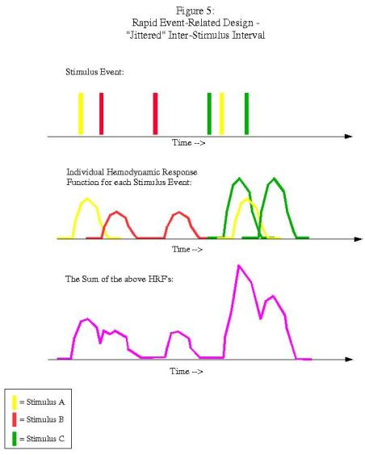
EVENT-RELATED
EFFICIENCY
JITTERED
INTER-STIMULUS
INTERVALS
YOUR
TITLE HERE
Andy’s Brain Blog

Slide 47
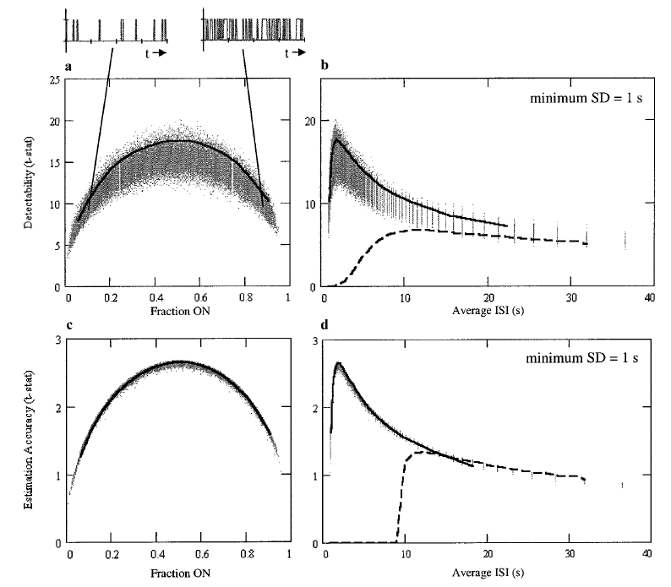
EFFECTS OF ISI ON POWER
Birn et al. (2002)

Slide 48
DRAWBACKS
OF EVENT-
RELATED
DESIGNS

More things to go wrong than block design
Reduced efficiency
Longer experiments
More dependent on accurate HRF modeling
Increased task switching

Slide 49
WEEK 4
FUNCTIONAL MRI I
SAMPLING
BIAS

Slide 50
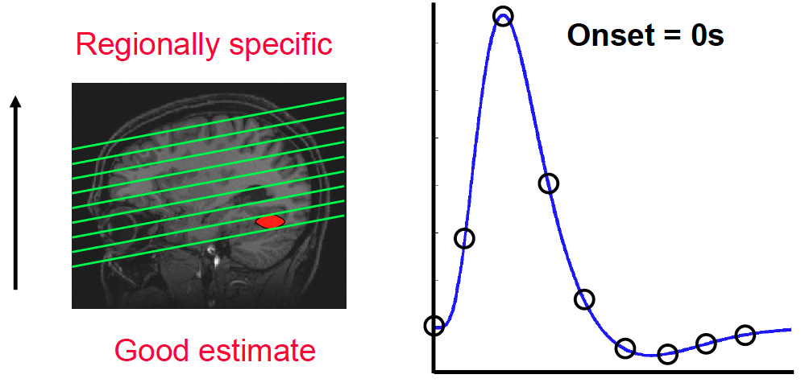
SAMPLING BIAS
Sonia Bishop (2015)

Slide 51
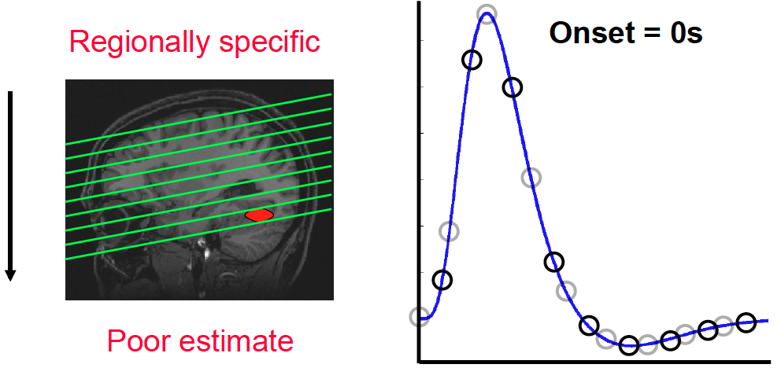
SAMPLING BIAS
Can underestimate effect sizes
Sonia Bishop (2015)

Slide 52
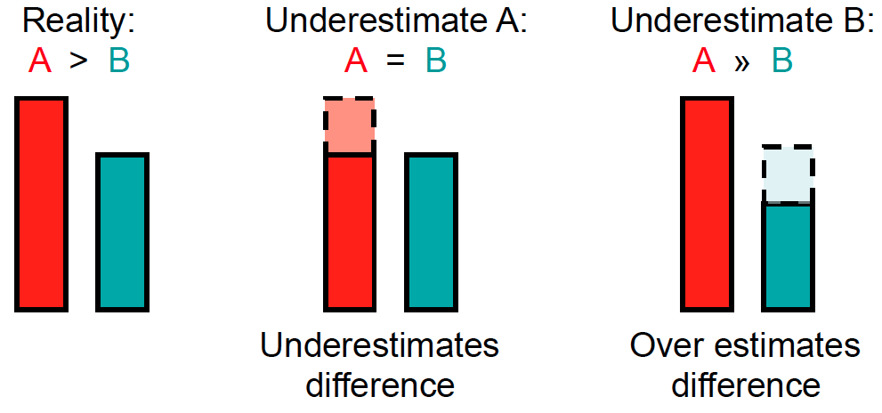
EFFECTS OF SAMPLING BIAS
Sonia Bishop (2015)

Slide 53
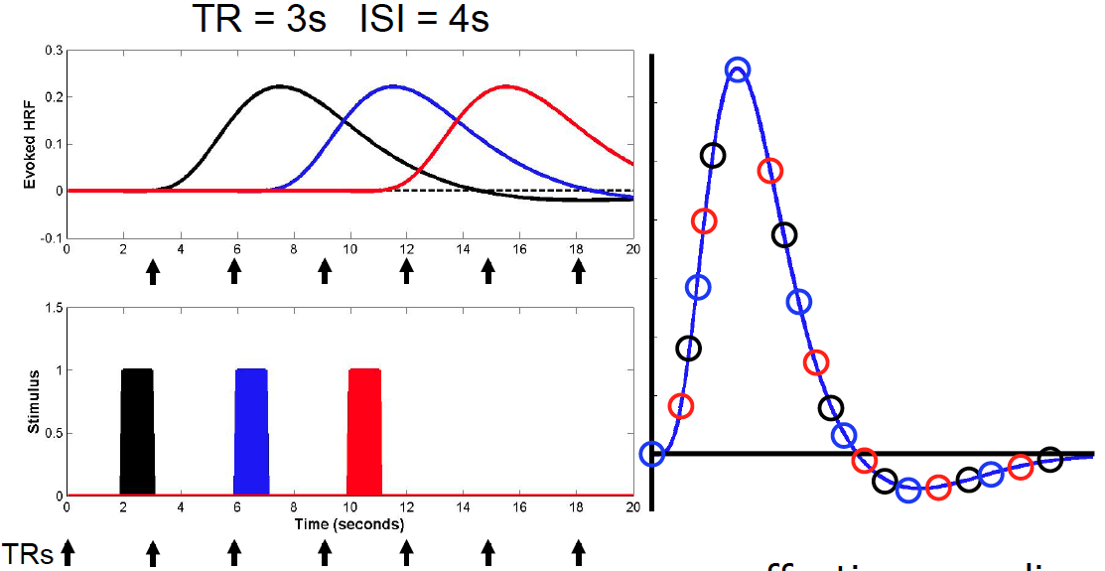
OVERSAMPLING
Sonia Bishop (2015)
Effective sampling rate of 1s

Slide 54
OVERSAMPLING
Sonia Bishop (2015)
Needs a fixed relationship between TR and ISI
Best for block designs
Can work for event-related designs with fixed ISI with randomized stimulus order and +/− null trials

Slide 55
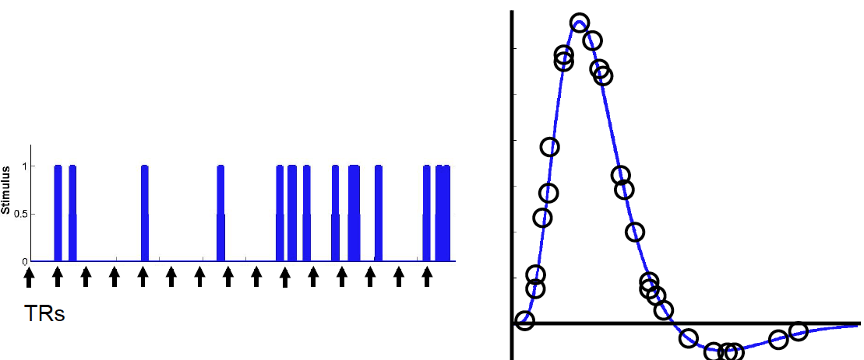
JITTERING ISI
Jittered ISI naturally gives random sample of HRF
Sonia Bishop (2015)

Slide 56
WEEK 4
FUNCTIONAL MRI I
MIXED BLOCK
& EVENT-RELATED
DESIGNS

Slide 57
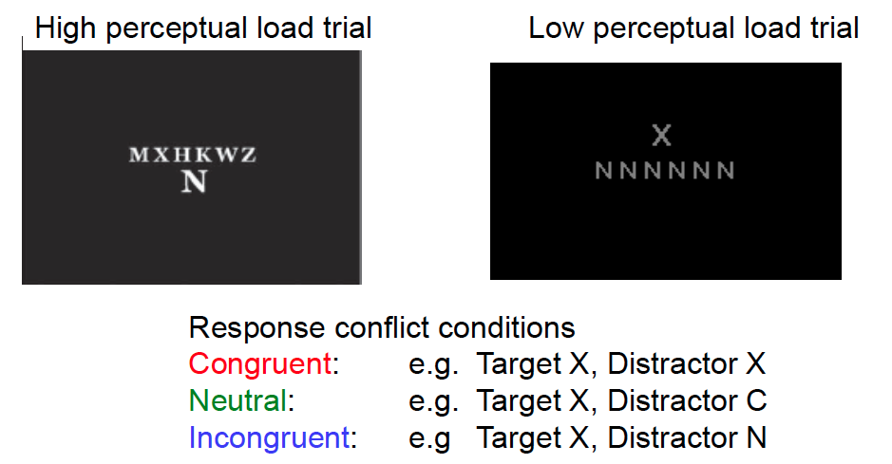
MIXED DESIGNS
HOW DO RESPONSE CONFLICT (INTERFERENCE) EFFECTS CHANGE AS A FUNCTION OF PERCEPTUAL LOAD?
Bishop (2009). Nature Neuroscience.

Slide 58
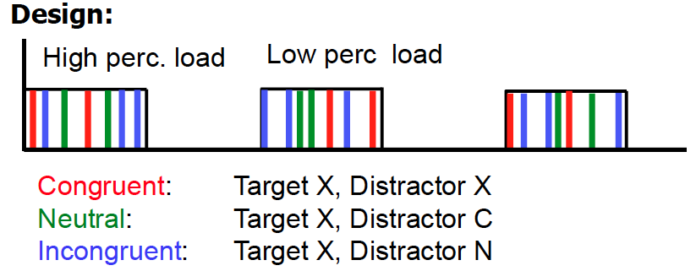
Bishop (2009). Nature Neuroscience.
Notes:
Block perceptual load manipulation so subjects can get into attentional
‘set’ and to reduce task switching effects
• Have response conflict vary event-related so avoid response conflict
effects washing out due to strings of incongruent trials increasing
expectancy of and preparation for high conflict trials

Slide 59
BACK TO THE ANTISACCADE EXAMPLE
Equal number of anti-saccades and pro-saccades
²/₃ trials are full anti-saccade or pro-saccade trials (preparation + saccade)
¹/₃ trials are half saccade (preparation only)

Slide 60
BACK TO THE ANTISACCADE EXAMPLE
Factorial design
Type of saccade (anti, pro) × Trial type (full, half)

Slide 61
BACK TO THE ANTISACCADE EXAMPLE
Factorial design
Type of saccade (anti, pro) × Trial type (full, half)
What type of design to use?

Slide 62
BACK TO THE ANTISACCADE EXAMPLE
Factorial design
Type of saccade (anti, pro) × Trial type (full, half)
What type of design to use?
MIXED DESIGN
Block type of saccade
Randomize full and half trials

Slide 63
What is your question?
What is the best way to evaluate it?
Subtraction, parametric, factorial, conjunction, adaptation; group level covariate?
Blocked, event-related, mixed?
Movement
is your paradigm extra likely to have this?
How long is your experiment?
How many blocks/events needed?
TR? (oversample, jitter)
Acquisition: Whole brain? Resolution?
Extra few scans to help registration?
TASK-BASED fMRI
DESIGN
CHECKLIST

Slide 64
How many subjects?
Collect behavioural responses?
Collect physiological responses?
Counter-balancing
Make sure your subjects know what they are doing
TASK-BASED fMRI
DESIGN
CHECKLIST

Slide 65
WEEK 4
FUNCTIONAL MRI I
TASK FREE
DESIGNS

Slide 66
TASK FMRI
VS
rsFMRI
changes in BOLD signal attributed to experimental paradigm
“brain function mapped onto brain regions” ➔ localization
generally largely ignoring any intrinsic, ongoing (spontaneous) brain activity
Spontaneous brain activity in fMRI in the absence of experimental stimulations
mainly temporally correlated fMRI signal changes across the brain during ‘rest’ (RSNs)
the resting brain consumes 20% of the body’s energy (mostly to support ongoing neuronal signaling), task-related changes in neuronal metabolism are only about 5% (Raichle et al. (2001), PNAS)
Iglasias, Methods & Models FS 2015

Slide 67
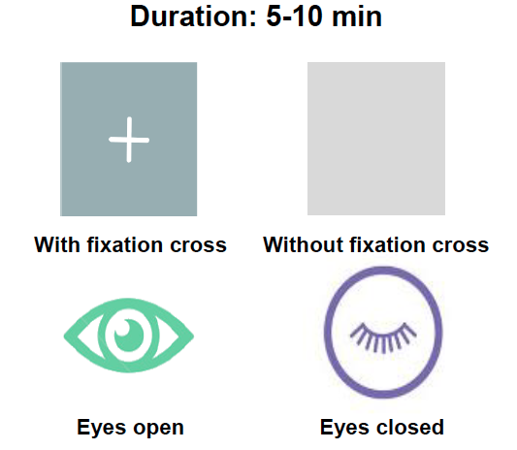
RESTING-
STATE
ACQUISITION
Iglasias, Methods & Models FS 2015

Slide 68
RESTING STATE FUNCTIONAL MRI […] IS A […] METHOD FOR EVALUATING REGIONAL INTERACTIONS THAT OCCUR WHEN A SUBJECT IS NOT PERFORMING AN EXPLICIT TASK.
http://www.humanconnectome.org/about/project/resting-fmri.html

Slide 69
RESTING STATE FUNCTIONAL MRI […] IS A […] METHOD FOR EVALUATING REGIONAL INTERACTIONS THAT OCCUR WHEN A SUBJECT IS NOT PERFORMING AN EXPLICIT TASK.
http://www.humanconnectome.org/about/project/resting-fmri.html

Slide 70
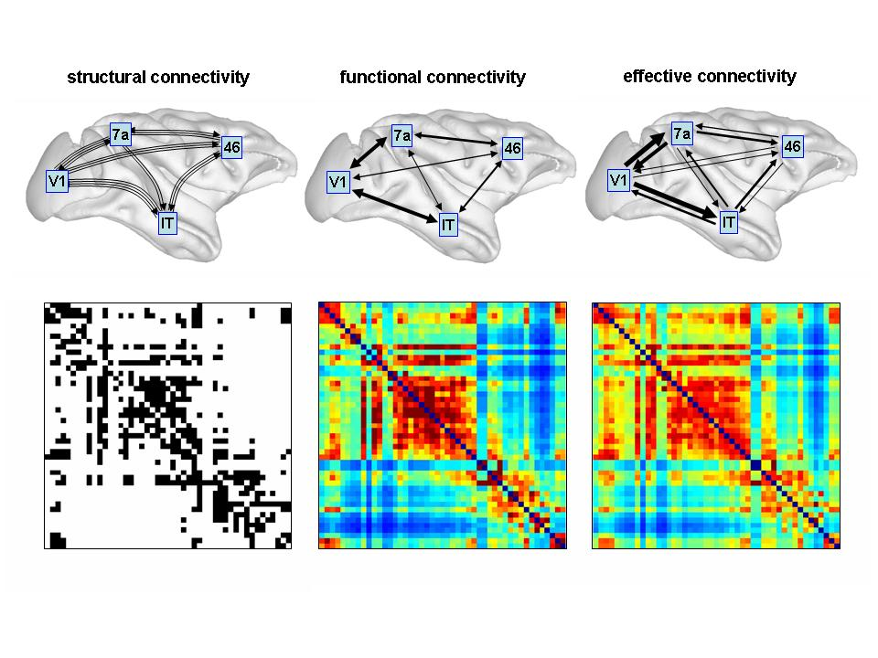
Presence of axonal connections
Statistical dependencies between regional time series
Causal (directed) influences between neuronal populations
Sporns 2007, Scholarpedia
Notes:
anatomical/structural connectivity = presence of axonal connections
functional connectivity = statistical dependencies between regional time series
effective connectivity = causal (directed) influences between neurons or neuronal populations

Slide 71
Presence of axonal connections
resting-state fcMRI might provide indirect information about the structural connectivity of the brain
Causal (directed) influences between neuronal populations
Sporns 2007, Scholarpedia
Notes:
anatomical/structural connectivity = presence of axonal connections
functional connectivity = statistical dependencies between regional time series
effective connectivity = causal (directed) influences between neurons or neuronal populations

Slide 72
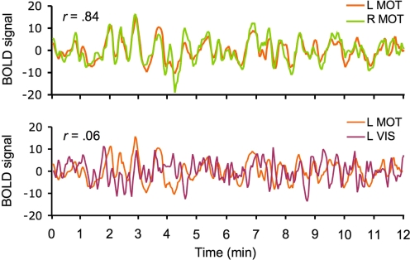
SPONTANEOUS
BOLD
ACTIVITY
Iglasias, Methods & Models FS 2015
vanDijk 2009

Slide 73
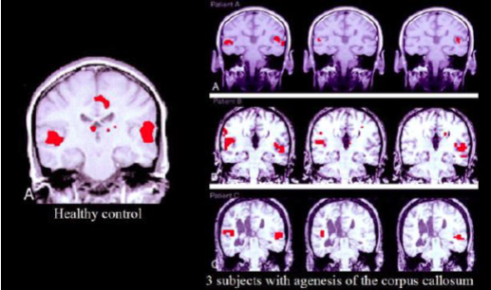
Patients
Healthy control
seed voxel from the right auditory cortex
activation from auditory cx during a text-listening task
FC with seed voxel selected in the R auditory Cx
FC with seed voxel selected in the left auditory Cx
Quigley, 2003

Slide 74
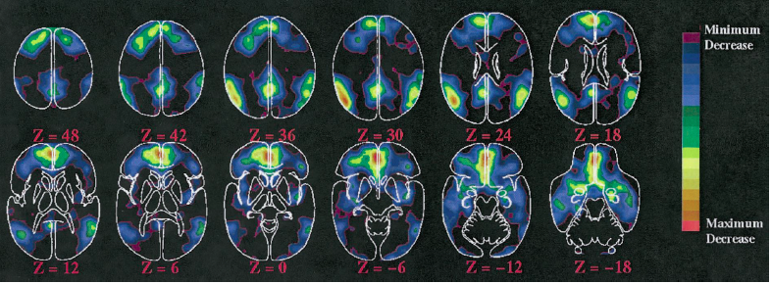
EARLY STUDIES
PET
Brain regions showing a decrease in metabolic activity during attention demanding cognitive tasks
DEFAULT MODE OF BRAIN FUNCTION
Raichle et al. (2001), PNAS

Slide 75
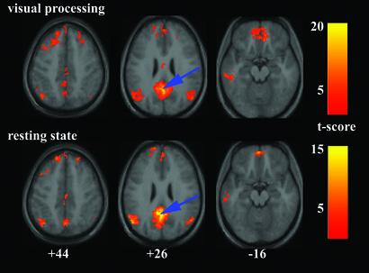
VISUAL PROCESSING
VS. RESTING-STATE NEURAL CONNECTIVITY FOR THE PCC
[-2 -51 27]
Grecius (2003), PNAS

Slide 76
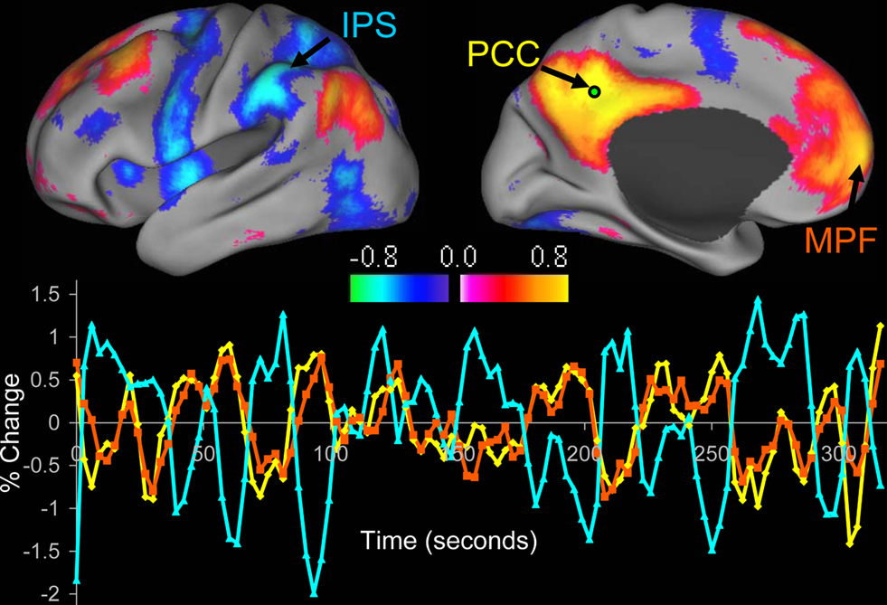
DEFAULT MODE NETWORK
A set of regions whose activations
Decrease during performance of active, engaging tasks
Increase during rest and reflection
Fox & Greicius (2010), Front Syst Neurosci

Slide 77
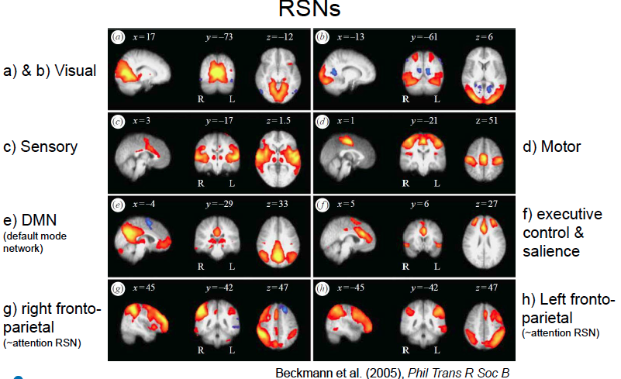
RSNs SPATIAL CHARACTERISTICS

Slide 78
WEEK 4
FUNCTIONAL MRI I
MODEL AND MODEL-FREE
APPROACHES

Slide 79
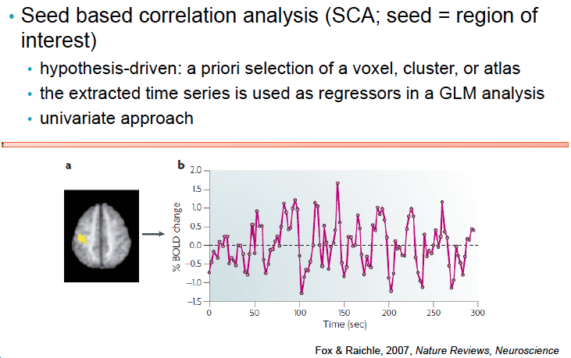
MODEL BASED

Slide 80
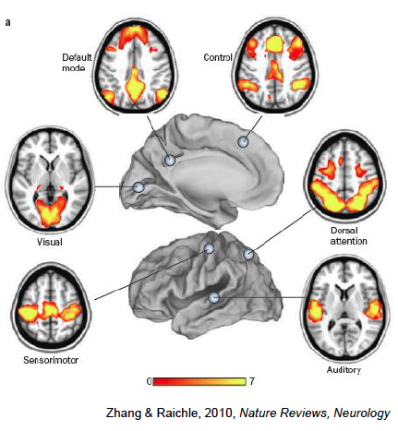
SEED CORRELATION ANALYSIS
Notes:
•Advantage:
•direct answer to a direct question (straightforward interpretation)
•Has moderate-to-high reliability
•Weakness:
•Residual confounds in the SCA time series (e.g. head motion)
•Bias attached to seed selection (see previous slide)
•Anatomical restrictions on the measurement of network connectivity (multiple regions must be manually defined before analysis in order to generate multiple network maps)

Slide 81
MODEL FREE
The signal in fMRI data is composed out of different sources of variability:
machine artefacts
physiological pulsation
head motion and
Spontaneous fluctuations in the blood oxygen level-dependent (BOLD) – signal
Goal: to express the original fMRI dataset as a linear combination of basis vectors (PCA) or statistically independent components (ICA)

Slide 82
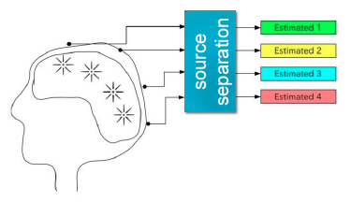
Iglasias, Methods & Models FS 2015

Slide 83
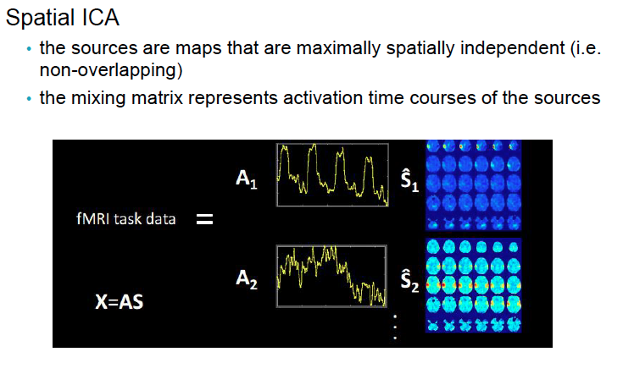
Iglasias, Methods & Models FS 2015

Slide 84
SPATIAL ICA
identifies stationary sets of voxels whose acivations vary together over time and are maximally distinguishable from other sets.
assumes that fMRI data consist of a set of spatially overlapping components, each with an independent spatial pattern and different time course
the term «independent» means that the algorithm minimizes the overlap between the components, but the components do not need to be orthogonal with each other
Notes:
Advantage:
•Data-driven; explore fMRI data in search of systematic variation, without necessarily adopting an a priori model for that variation
•Partition the four dimensional fMRI time series into a set of components that may reflect distinct aspects of brain functioning, and also sources of non-neuronal variance (related to movement, ventricles, WM, respiration)
•Weakness:
•Poorly chosen models (e.g. how to select the number of IC?)
•Variability in the hemodynamic response
•Loss of specificity in relation to a well-defined seed of interest, interpretation?

Slide 85
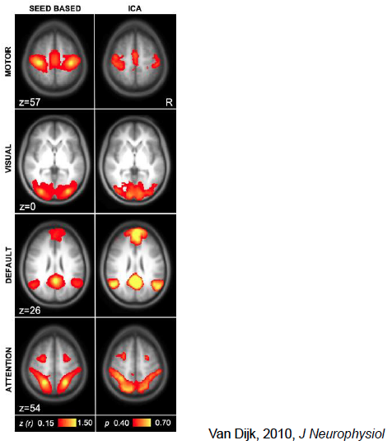
SEED CORRELATION
VS ICA

Slide 86
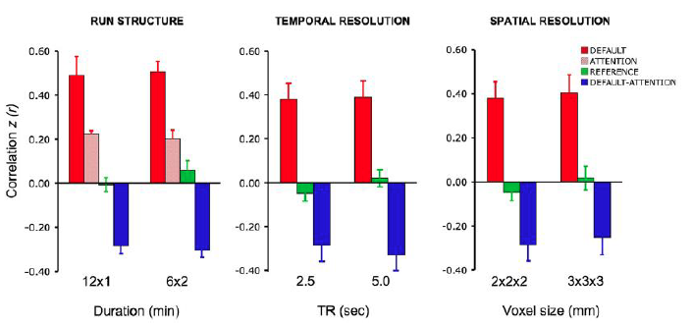
Van Dijk 2010. J. Neurophysiology

Slide 87
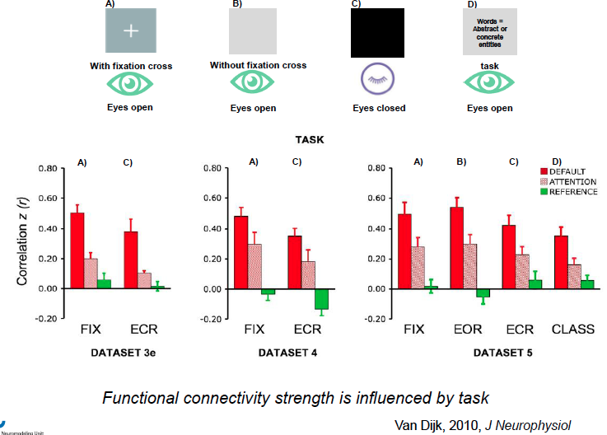

Slide 88





© 2018 BC CHILDREN’S HOSPITAL MRI RESEARCH FACILITY
This work is licensed under the Creative Commons Attribution-NONCOMMERCIAL-ShareAlike 4.0 International License. To view a copy of this license, visit http://creativecommons.org/licenses/by-nc-sa/4.0/..
THANK YOU
BCCH MRI Research Facility

Slide 89
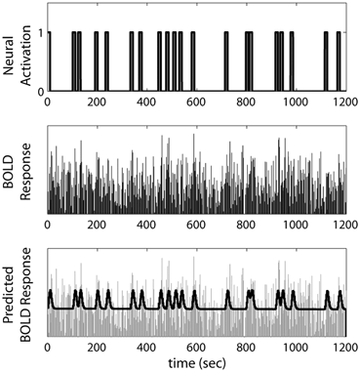
Ashby F. (2015) An Introduction to fMRI. In: Forstmann B., Wagenmakers EJ. (eds) An Introduction to Model-Based Cognitive Neuroscience. Springer, New York, NY. https://doi.org/10.1007/978-1-4939-2236-9_5

